Slide 1
TREND ANALYSIS DOGE, RIPPLE_XRP, ETHEREUM CRYPTO CURRENCES BY REGRESSION MODEL.
DATE : 25/03/2024
BATCH : 10
TEAM MEMBERS:
211420104262 – SRIMATHI S
211420104270 – SRI VARSSHINI S
211420104314 – YOHAMALAR R
GUIDE:
Dr.M.SANGEETHA,
M.Tech,.Ph.d
1

Slide 2
BASE PAPER LINK
Forecasting_and_Trading_of_the_Stable_Cryptocurrencies_With_Machine_Learning_and_Deep_Learning_Algorithms_for_Market_Conditions.pdf
2
1

Slide 3
ABSTRACT
Crypto currencies have gained immense significance and popularity in recent times. With thousands of digital currencies available, selecting the right one can be challenging for users.
In the financial sector, accurately predicting future prices is crucial for profitable investments in digital currencies. However, price prediction in this realm poses unique challenges, as it lacks physical goods or services as the basis, unlike stock prices.
Machine learning emerges as a pivotal tool for addressing this challenge and plays a vital role in price prediction.
This research analyzes three prominent currencies – Doge coin(Doge), Ripple_XRP(XRP), Ethereum(ETH) - employing three models: Bayesian Ridge, Huber Regressor, Elastic Net.
3
2

Slide 4
The experimental results demonstrate promising outcomes, showcasing the ability to predict digital currency prices for specific machine learning algorithms.
This advancement opens new avenues for informed decision-making and profitable ventures in the dynamic world of digital currencies.
Keywords: Trend analysis, Dogecoin, Ripple, Ethereum, Crypto currency, Regression model.
4
3

Slide 5
INTRODUCTION
The traditional financial system is characterized by numerous government rules, frameworks, and policies, with central banks playing a pivotal role. In such a system, individuals have to place their trust in a third party, known as the central bank.
However, the traditional financial system has its limitations, leading to the emergence of digital currencies.
Cryptocurrencies, as decentralized digital or virtual currencies, have come to the forefront. While thousands of digital currencies exist today, some have gained popularity while others have not.
The cryptocurrency market is dominated by a select group of coins, with the top 80% primarily covered by 10 prominent cryptocurrencies, including Bitcoin, Ethereum, Tether, BinanceCoin, USDCoin and others
5
4

Slide 6
While pinpointing the exact reasons for their price movements may be challenging, machine learning algorithms have proven effective in providing accurate price predictions. ​
In conclusion, the cryptocurrency market is characterized by a few dominant players, and predicting the price fluctuations of these digital assets is a challenging yet vital task.
Leveraging machine learning algorithms, particularly regression methods, provides a promising approach to gaining insights into the dynamic and volatile nature of cryptocurrency prices. ​
6
5

Slide 7
EXISTING SYSTEM
Bitcoin the world’s first crypto currency started off with the mission to challenge the existing global financial order.
Bayesian Regression, a binary classification algorithm, was used to predict price variation in Bitcoin and the prediction gave almost 200% returns in less than 60 days when used with a trading strategy.
The objective is to understand how features of Bitcoin (such as transaction volume, cost per transaction) can affect the next day change in price level of Bitcoin through the use of an Artificial Neural Network (ANN).
Additionally, alternative methodologies like time-scale multifractal methods have been deployed to analyze Bitcoin’s volume and price patterns, offering valuable insights into its market behavior
7
6

Slide 8
DRAWBACKS
Alternative coins other than Bitcoin with power packed features that can be used in the decentralized finance does not have a standard prediction model.
Long-term Bitcoin price predictions are done at an accuracy of upto 55% using machine learning models.
Most of the existing works focuses mainly on Bitcoin and Ethereum while other alternatives such as Doge, Ripple are not taken into account.
8
7

Slide 9
PROPOSED SYSTEM
The proposed work is to provide users to look into other alternative coins and find out which ones besides Bitcoin are doing well in the market by finding trends and predictions using Machine learning Algorithms.
System for analyzing crypto currencies using regression models is to gain insights into their price movements and make informed predictions.
Regression analysis, a statistical modeling technique, can provide valuable insights into the factors influencing crypto currency prices and enable the development of predictive models.
The proposed system aims to enhance the understanding of crypto currency trends and provide valuable insights for traders, investors, and researchers.
It can contribute to the development of more accurate price prediction models and assist in risk management strategies in the crypto currency market.
9
8

Slide 10
MERITS
Our suggested method will forecast bitcoin alternatives, generating greater returns for investors.
Regression is a supervised machine learning technique which is used to predict continuous values. Thus the ultimate goal of the regression algorithm is to plot a best-fit line or a curve between the data.
The proposed regression algorithms allows a useful mechanism to deal with insufficient data, or poor distributed data.
The deployment procedure was put into effect by using Frontend codes like Html, Css, Bootstrap and Python Framework like Django or Flask.
10
9

Slide 11
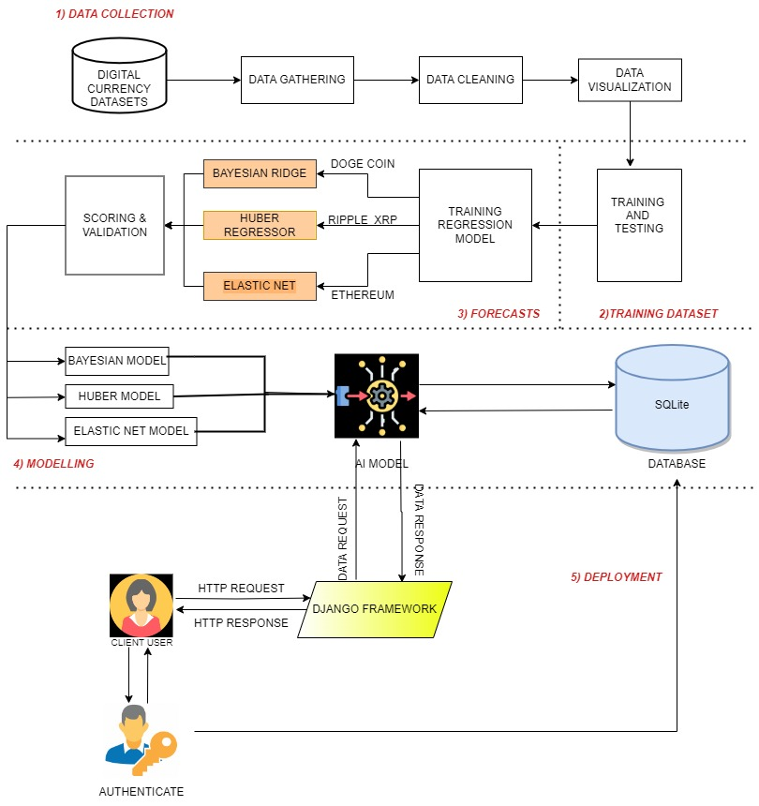
SYSTEM ARCHITECTURE
11
10

Slide 12
LIST OF MODULES
Implementing Bayesian Ridge
Implementing Huber Regressor
Implementing Elastic Net
Deployment ( User Interface )
PRIOR TO THAT:
Data Pre-Processing
Data analysis for Visualization
12
11

Slide 13
MODULE DESCRIPTION
MODULE 1 : BAYESIAN RIDGE
In Bayesian Ridge regression, a prior distribution is assigned to the regression coefficients, typically a Gaussian (normal) distribution. This prior represents our initial beliefs about the coefficients' values, and it is updated based on the observed data through Bayes' theorem to form a posterior distribution. This posterior distribution provides a range of possible coefficient values along with their associated uncertainties.
Bayesian Ridge also provides estimates of the predictive uncertainty, making it useful in scenarios where you not only want point estimates of the coefficients but also a measure of their reliability. This is particularly beneficial when making predictions, as it allows you to quantify the uncertainty associated with your predictions.
13
12

Slide 14
MODEL SETUP
1. Linear Model:
Start with the standard linear regression model: Y=Xβ+ϵ where Y is the target variable, X is the design matrix of features, β is the vector of coefficients, and ϵ is the error term.
2. Likelihood:
Assume the errors (ϵ) follow a Gaussian distribution:
p(Y ∣X,β,α)=N(Xβ,α−1I) where α is the precision (inverse variance) parameter.
The goal is to strike a balance between fitting the data and regularizing the model to avoid over fitting, especially in the presence of multicollinearity
14
13

Slide 15
MODULE 2 : HUBER REGRESSOR
The Huber Regressor is a robust linear regression algorithm used for modeling and analyzing data, particularly when there are potential outliers or errors in the dataset.
The Huber Regressor introduces a tuning parameter called the "delta" that determines the threshold at which the loss function transitions from the quadratic to linear part.
It strikes a balance between the robustness of methods like the Least Absolute Deviations (LAD) regression and the efficiency of Ordinary Least Squares (OLS) regression, making it a useful choice in situations where traditional linear regression models may not perform well due to the presence of extreme values.
15
14

Slide 16
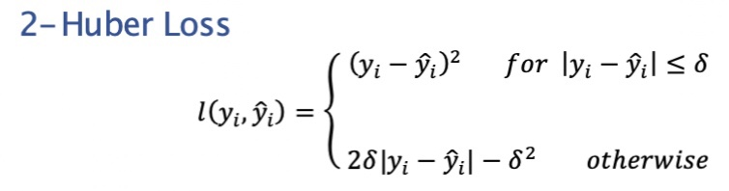
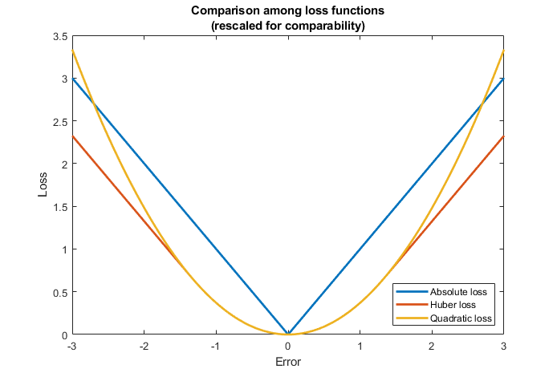
HUBER LOSS
16
15

Slide 17
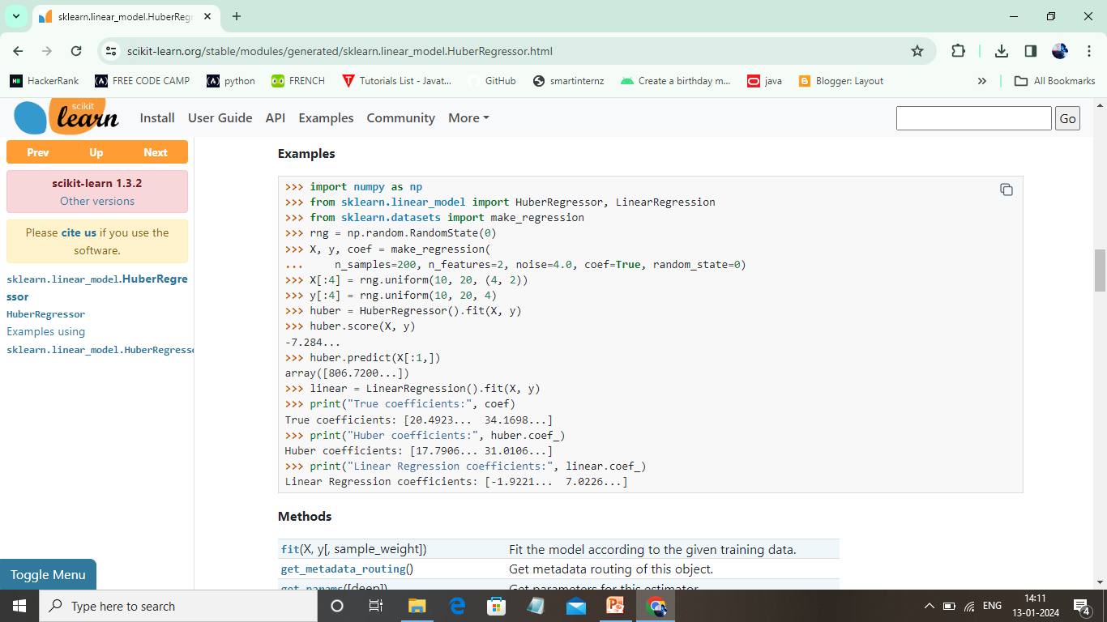
WHY HUBER REGRESSOR IS EFFICIENT?
17
16

Slide 18
MODULE 3 : ELASTIC NET REGRESSION
Elastic net is a penalized linear regression model that includes both the L1 and L2 penalties during training. Using the terminology from “The Elements of Statistical Learning,” a hyper parameter “alpha” is provided to assign how much weight is given to each of the L1 and L2 penalties.
The benefit is that elastic net allows a balance of both penalties, which can result in better performance than a model with either one or the other penalty on some problems.
Another hyperparameter is provided called “lambda” that controls the weighting of the sum of both penalties to the loss function.
A default value of 1.0 is used to use the fully weighted penalty; a value of 0 excludes the penalty. Very small values of lambda, such as 1e-3 or smaller, are common.
18
17

Slide 19
ALGORITHM
loss = sum i=0 to n (y_i – yhat_i)^2
where, predictions (yhat) and the expected target values (y).
l2_penalty = sum j=0 to p beta_j^2
l1_penalty = sum j=0 to p abs(beta_j)
where, more samples (n) than input predictors (p)
elastic_net_penalty = (alpha * l1_penalty) + ((1 – alpha) * l2_penalty)
elastic_net_loss = loss + (lambda * elastic_net_penalty)
19
18

Slide 20
ENVIRONMENT REQUIREMENTS
Software Requirements:
Operating System : Windows 10
Tool : Anaconda with Jupyter Notebook
Hardware requirements:
Processor : Pentium IV/III
Hard disk : minimum 80 GB
RAM : minimum 4 GB
20
19

Slide 21
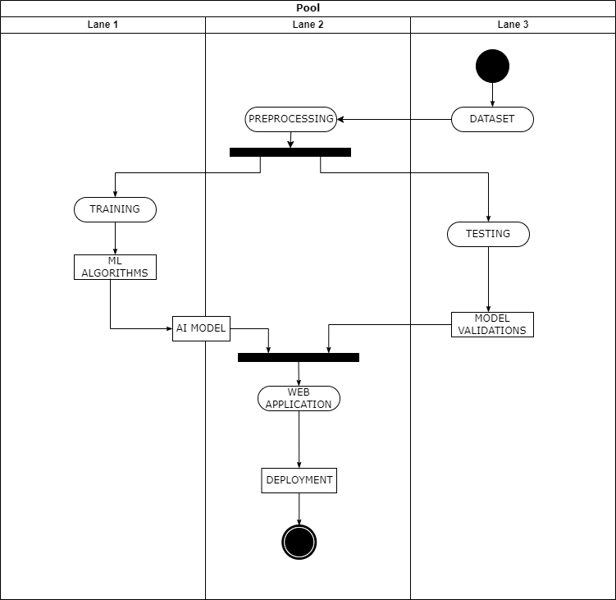
ACTIVITY DIAGRAM
22
21

Slide 22
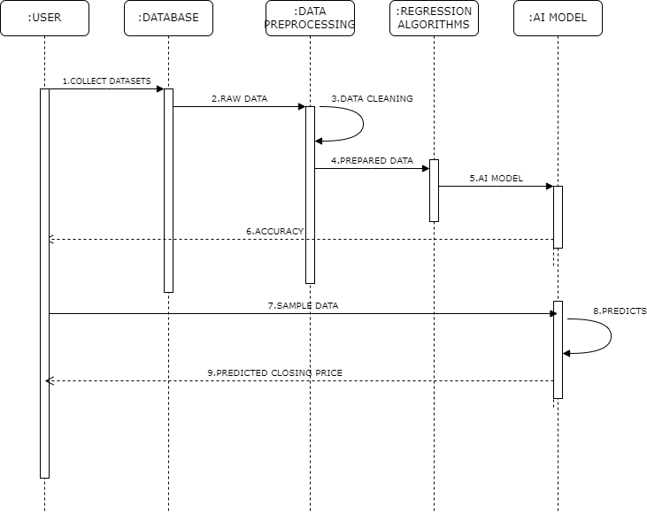
SEQUENCE DIAGRAM
22
21

Slide 23
MODEL VALIDATIONS
MEAN ABSOLUTE ERROR (MAE)
A commonly used metric in machine learning to evaluate regression model performance is Mean Absolute Error (MAE). This appraise the mean absolute difference among the predicted and observed values.
For each data point:
Calculate the absolute difference between the predicted value (ŷ) and the actual value (y).
|ŷ - y|
Take the mean of all these absolute differences to get the MAE:
MAE = (1 / n) * Σ|ŷ - y|
2. ROOT MEAN SQUARED ERROR (RMSE)
RMSE holds significant importance in machine learning, particularly when evaluating regression models. It serves as a fundamental measure for assessing the typical discrepancy between anticipated values and actual values, offering valuable insights into model accuracy.
23
22

Slide 24
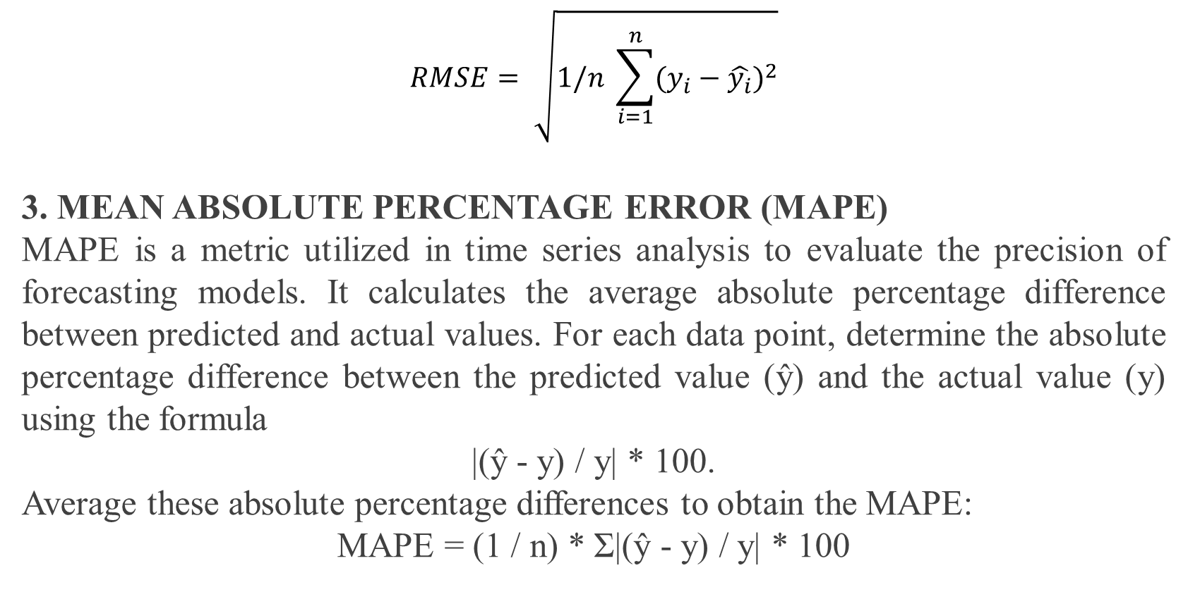
$$RMSE= \sqrt{1/n \sum_{i=1}^{n}{{(y_{i}−\hat{y_{i}})}^{2}}}$$
3. MEAN ABSOLUTE PERCENTAGE ERROR (MAPE)
MAPE is a metric utilized in time series analysis to evaluate the precision of forecasting models. It calculates the average absolute percentage difference between predicted and actual values. For each data point, determine the absolute percentage difference between the predicted value (ŷ) and the actual value (y) using the formula
|(ŷ - y) / y| * 100.
Average these absolute percentage differences to obtain the MAPE:
MAPE = (1 / n) * Σ|(ŷ - y) / y| * 100
24
23

Slide 25
LITERATURE SURVEY
SL.NO | DATE | TITLE | AUTHORS | METHODOLOGY | LIMITATIONS
1 | December 2023 | Cryptocurrency Price Prediction Model Based on Sentiment Analysis and Social Influence | Fatemeh Feizian, Babak Amiri | The aim of this study was to compare the performance of different methods of sentiment analysis in predicting the prices of five different cryptocurrencies with the LSTM, ARIMA, and MLP models. As the number of followers indicates the level of influence that anybody has on the social network, the polarity scores of the tweets published by Twitterers were weighted based on the publishers’ influence factor, which can be identified by the number of followers. | The identification of all effective factors and encountering complexities, could enhance the performance of prediction models.
25
24

Slide 26
2 | October 2023 | Good volatility, bad volatility, and the cross section of cryptocurrency returns | Zehua Zhang, Ran Zhao | RSJsorted cryptocurrency portfolios yield statistically and economically significant differences in the subsequent portfolio returns. After controlling for cryptocurrency market characteristics and existing risk factors, the differences remain significant. The investor attention explains the predictability of realized jump risk in future cryptocurrency returns. | Low frequency transaction data have low accuracy rate
3 | October 2023 | Price Prediction of Digital Currencies using Machine Learning | Ashutosh Dhar Dwivedi, Subhayu Dutta, Subhrangshu Adhikary, Jens Myrup Pedersen | The experimental results demonstrate promising outcomes, showcasing the ability to predict digital currency prices with an impressive R2 score of 1.0 for specific machine learning algorithms. This advancement opens new avenues for informed decision-making and profitable ventures in the dynamic world of digital currencies | Accuracy can be improved by various algorithms for various digital currencies
26
25

Slide 27
4 | June 2023 | Enhancing Cryptocurrency Price Forecasting Accuracy: A Feature Selection and Weighting Approach With Bi-Directional LSTM and Trend-Preserving Model Bias Correction | Muhammed Rafi, Qublai Ali Khan Mirza, Muhammad Izaan Sohail, Maria Aliasghar, Arisha Aziz | Feature selection and weighting approach based on Mean Decrease Impurity(MDI) features, Bi-directional LSTM and with a trend preserving model bias correction (CUSUM control charts for monitoring the model performance over time) to forecast Bitcoin and Ethereum values . | The paper focuses mainly in Bitcoin and Ethereum and not other digital currencies.
5 | May 2023 | Analysis of Various Machine Learning and Deep Learning Algorithms for Bitcoin Price Prediction | Babita Sonare, Sonali Patil, Rohini Pise, Siddhesh Bajad, Siddhesh Ballal | Comparing various ML and DL algorithms to find out the best algorithm for short term and long term price prediction of Bitcoin crypto currency. | Works well for Bitcoin. Other digital currencies are not taken into account.
27
26

Slide 28
6 | April 2023 | Hedging effectiveness of cryptocurrencies in the European stock market | Luca Gambarelli, Gianluca Marchi, Silvia Muzzioli | The aim of the paper is to examine the hedging effectiveness of cryptocurrencies and cryptocurrency portfolios for European equities and employed in a linear and nonlinear Autoregressive Distributed Lag (ARDL) framework. | Future research should constantly monitor the evolution of the interrelation between crypto currencies and traditional asset classes over time.
7 | January 2023 | Price Prediction of Bitcoin and Ethereum - A Machine Learning Approach | Sriman B, Tamil Iniyal T, Thasmiya J, Taariq Ziyaadh J, Sriranjani, Teju Thomas | Implement the efficient machine learning and deep learning- based models specifically CNN, LSTM and GRU to handle the price | Low accuracy rate. Other machine learning algorithms can improve accuracy.
28
27

Slide 29
8 | December 2022 | A Combination of Technical Indicators and Deep Learning to Predict Price Trends for Short-Term Cryptocurrency Investment | Nhan Thi Cao, Dai Quoc Nguyen, An Hoa Ton-That | Used Multi-Scale Residual convolutional module for price prediction | Works well only for Bitcoin and Ethereum
9 | December 2022 | Ethereum and Binance Price Forecasting Using Machine Learning | K Chaithanya Kumar, Rajesh M | The work proposes to foresee the future costs of Cryptographic forms of money like Ethereum and Binance Coin utilizing AI draws near. | Binance coin is not widely used in anonymous payment.
10 | October 2022 | Implementation of Support Vector Regression for Polkadot Cryptocurrency Price Prediction | Deny Haryadi, Arif Rahman Hakim, Dewi Marini Umi Atmaja, Syifa Nurgaida Yutia | Polkadot cryptocurrency price prediction analysis using the Support Vector Regression algorithm has a good predictive accuracy value, including for Polkadot daily closing price data, namely with a radial basis function (RBF) kernel with cost parameters | SVR algorithm is not suited for large complex datasets.
29
28

Slide 30


SCREENSHOTS
Fig 1. Home page
Fig 2. Doge Prediction page
30
29

Slide 31


Fig 3. Ethereum Prediction page
Fig 4. Ripple_XRP Prediction page
31
30

Slide 32

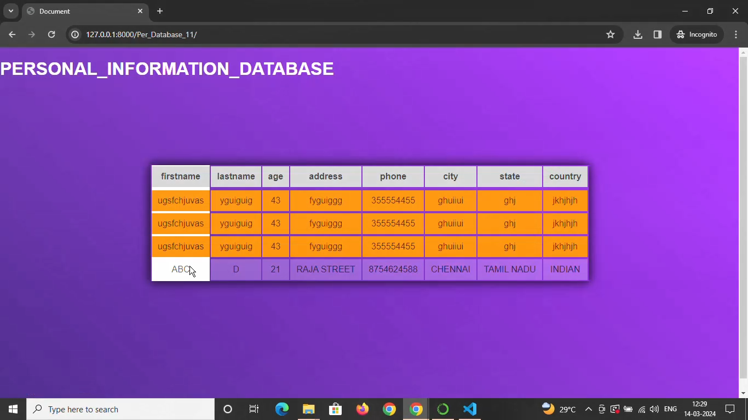
Fig 5. Team Member Details
Fig 6. Users Personal Information Database
32
31

Slide 33
REFERENCES
Nakamoto, S. (2008). Bitcoin: A peer-to-peer electronic cash system. https://bitcoin.org/bitcoin.pdf
Harvey, C. (2014). Bitcoin myths and facts. Working paper, Duke University. http://ssrn.com/abstract=2479670
Athey, S., I. Parashkevov, V. Sarukkai, and J. Xia (2016). Bitcoin pricing, adoption, and usage: Theory and evidence. Working paper, Stanford University.
Pagnotta, E. and A. Buraschi (2018). An equilibrium valuation of bitcoin and decentralized network assets. Available at SSRN: https://ssrn.com/abstract=3142022.
Raskin, M. and D. Yermack (2016). Digital currencies, decentralized ledgers, and the future of central banking. Working paper, National Bureau of Economic Research
33
32

Slide 34
A. Ho, R. Vatambeti and S. K. Ravichandran, "Bitcoin Price Prediction Using Machine Learning and Artificial Neural Network Model", Indian Journal of Science and Technology, vol. 14, no. 27, pp. 2300-2308, 2021.
Z. Li, Q. Lu, S. Chen, Y. Liu and X. Xu, "A Landscape of Cryptocurrencies", in 2019 IEEE International Conference on Blockchain and Cryptocurrency (ICBC), pp. 165-166, 2019.
H. Luo and Y. Liu, "A prediction method based on improved ridge regression", 2017 8th IEEE International Conference on Software Engineering and Service Science (ICSESS), pp. 596-599, 2017.
I. Merediz-Sola and A. F. Bariviera, "A bibliometric analysis of‘ bitcoin scientific production", Research in International Business and Finance, vol. 50, pp. 294-305, 2019
K. Rathan, S. V. Sai and T. S. Manikanta, "Crypto-currency price prediction using decision tree and regression techniques", 2019 3rd International Conference on Trends in Electronics and Informatics (ICOEI), pp. 190-194, 2019
34
33

Slide 35
D. Haryadi, A. R. Hakim, D. M. U. Atmaja and S. N. Yutia, "Implementation of support vector regression for polkadot cryptocurrency price prediction", JOIV: International Journal on Informatics Visualization, vol. 6, no. 1-2, pp. 201-207, 2022.
A. Sunyaev, Distributed Ledger Technology, Cham:Springer International Publishing, pp. 265-299, 2020, [online] Available: https://doi.org/10.1007/978-3-030-34957-8
D. Chowdhury, A. Dey, R. Garai, S. Adhikary, A. D. Dwivedi, U. Ghosh, et al., "Decrypt: a 3des inspired optimised cryptographic algorithm", Journal of Ambient Intelligence and Humanized Computing, vol. 14, no. 5, pp. 4745-4755, 2023.
T. Phaladisailoed and T. Numnonda, "Machine learning models comparison for bitcoin price prediction", 2018 10th International Conference on Information Technology and Electrical Engineering (ICITEE), pp. 506-511, 2018.
Y. Liu and A. Tsyvinski, "Risks and returns of cryptocurrency", The Review of Financial Studies, vol. 34, 2020.
34

Slide 36
THANK YOU !

